Slide 1

Memory Design and Testing (PVL 331)
Dr. Rajneesh Sharma
Assistant Professor
Thapar Institute of Engineering & Technology, Patiala

Slide 2
Module 1
Basics of Semiconductor Memory
Internal Organization of Memory Chips
SRAM Cell
DRAM cell
Ferroelectric Memory
Flash Memory Cell
Notes:
In module 1 we will cover six topics. We will start from the basics of semiconductor memory in which we will cover brief history, growth and different types of semiconductor memory. Next I will tell you about internal organization of memory chip in which we discuss I/O interface circuit and peripheral circuits.
After that SRAM and DRAM would be dealt in detail. Non-voltalie memory technology i.e. Ferroelectric and Flash Memory would be cover in the last part of the module 1.

Slide 3
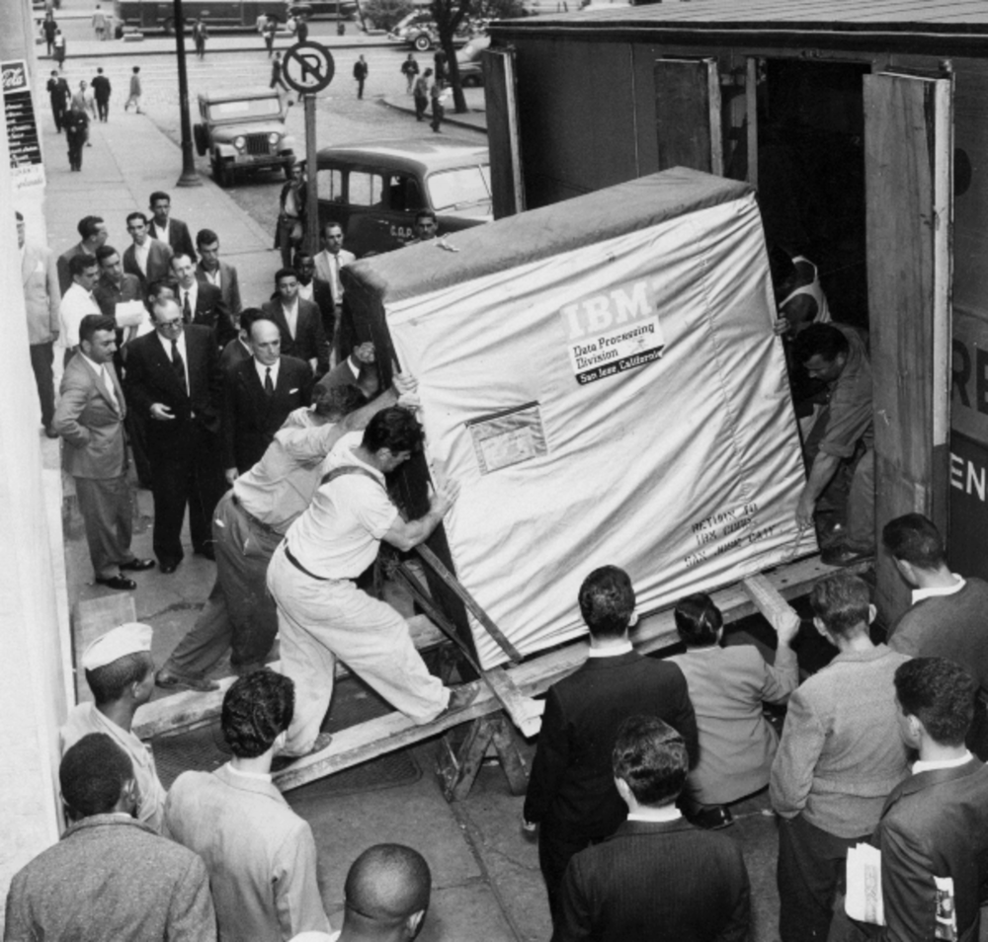
Basics of Semiconductor Memory
Fig. 1 In 1956, it took four men and a truck to transport 5MB of memory [IBM, 2016 ]
Notes:
In the Figure 1 you can see that four men required to push 5 MB of memory in 1956 [5MB is equivalent to 1 song on your mobile]. This memory is basically magnetic disk storage. The same magnetic disk storage technology is used in PCs currently. However, nowadays its far more compact and denser as compare to the memory shown in Fig. 1 . It is called HDD and it carry upto 2 TB of information. So you can imagine how much we have progressed in memory design. The memory shown in this picture was going to used for IBM 305 RAMAC (Random Access Method of Accounting and Control) which was the first commercial computer that used a moving-head hard disk drive (magnetic disk storage) for secondary storage.

Slide 4
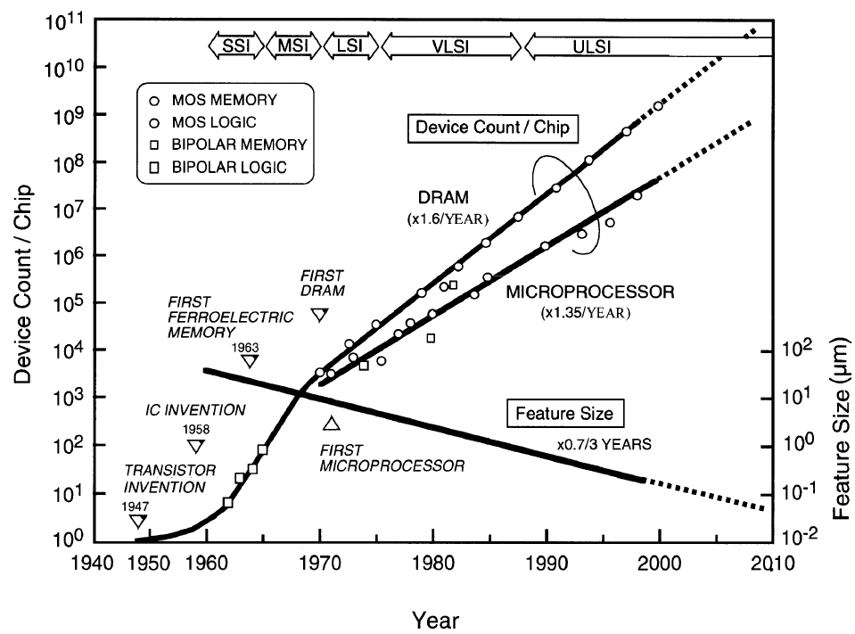
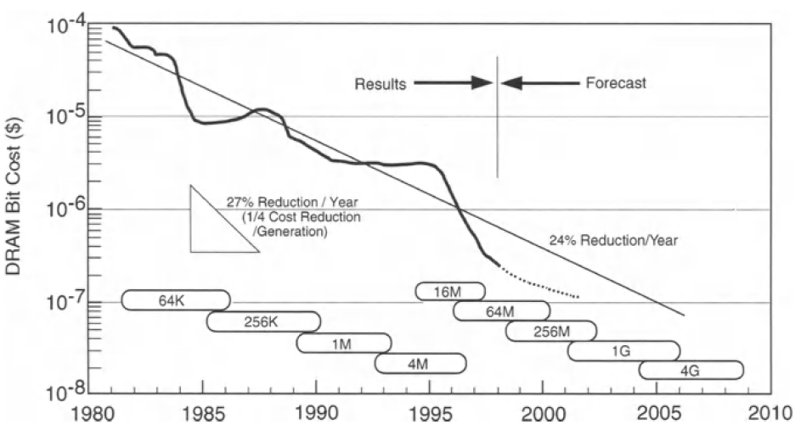
Basics of Semiconductor Memory
Fig. 2 (a) Trend in device count per chip (b) Cost per Bit
Notes:
However, The VLSI memory era truly began when the first production of semiconductor memory was announced by IBM and Intel in 1970. Semiconductor Memory industry progressed exponentially thereafter E.g. DRAM has witnessed an exceptional increase in memory capacity from the 1-Kb level in 1970 to the 1-Gb level in 2000.
This growth trend can be observed in fig. 2 (use highlighter to draw line from 1970 to 2000) This fig. represent device count per chip over the years. Solid line represent actual trend whereas dotted lines represent the projection. Starting from the transistor invention in 1947, we have witnessed various milestones in the growth of semiconductor industry which have paved the way to large-scale integrated circuit (LSI) memories, as shown in this Fig. The increase in memory chip capacity has skyrocketed with the help of the ever-higher-density MOS/CMOS design and technology. The dense memories have given computers, the benefit of a dramatically reduced cost per bit and far superior performance. In fig. 2.b, We can see that Cost has been cut at an annual reduction of around 24%, proving of great benefit to system designers. Currently DRAM bit cost is around 10⁻¹²
If we talk about current scenario, In 2016, Samsung shipped DRAM of 18nm device. The 8Gbit part is 30% faster and consumes less power than its previous version. It also incorporates the DDR4 interface standard. Here DDR stands for Double-data-rate technology which transfers data twice per clock cycle in the device. DDR4 operates up to 3,200Mbps.

Slide 5
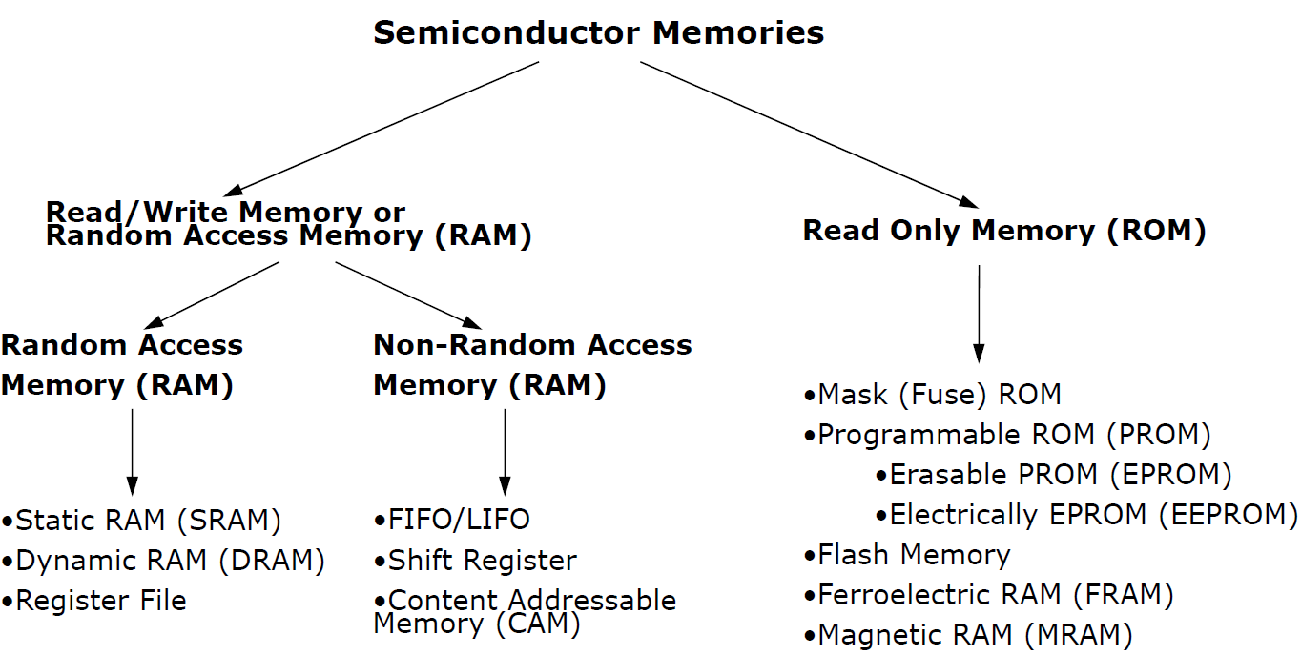
Basics of Semiconductor Memory
Fig.3 Overview of Memory Types
Notes:
The semiconductor memory [1.9] now widely used is categorized as RAM (Random Access Memory) and ROM (Read Only Memory), as shown in Fig. 3. RAM permits random write and read operations for any memory cell in a chip. The stored data are usually volatile when the power-supply voltage is turned off. RAM is further classified into DRAM (Dynamic RAM) and SRAM (Static RAM). Due to the advantage of low cost, despite medium speed, DRAM is widely and extensively used for the main memory in personal computers, mainframe computers, and engineering workstations.
SRAM, which features high speed and ease of use, despite high cost, is also used for the main memory of supercomputers, the cache memory in mainframe computers, engineering workstations, and microprocessors, and memory in handheld equipment.
Now comes to the non-random access memory. It is divided into FIFO/LIFO, shift register and CAM. Series access memory is a class of data storage devices that read stored data in a sequence e.g. FIFO,LIFO and shift register. This is in contrast to random access memory (RAM) where data can be accessed in any order.
CAM Content-addressable memory is computer memory that operates like a hardware search engine for search-intensive applications. CAM is capable of searching its entire contents in a single clock cycle. It does that by pairing the SRAM-based memory with additional logic comparison circuitry that that is active on every clock cycle. The way CAM functions is almost the opposite of random access memory (RAM). To retrieve data residing on RAM, the OS provides the memory address where the data is stored. On the other hand, Data stored on CAM can be accessed by searching for the content itself, and the memory retrieves the addresses where that content can be found. Because of its parallel nature, CAM is much faster than RAM for searching.
Next is ROM i.e. Read only Memory:-ROM, dedicated to read operation with non-volatile stored data, is classified into two categories, depending on the process of the write procedure: PROM (Programmable ROM), in which data are written after chip fabrication; and Mask ROM, in which data are written during chip fabrication by the use of a photo mask that contains the write data. PROM is further categorized into two, depending on its erasable or non-erasable characteristics; EPROM (Erasable and Electrically PROM) and EEPROM (Electrically Erasable PROM). EPROM erases the data by exposing the memory cells to ultraviolet rays, while it writes the data by electrical means. In EEPROM, the erase and write operations are both performed by electrical means. There are some drawbacks:
the write speed is two to three orders slower than that of RAM, and there is an upper limit on the number of write operations of 10⁴ -10⁵ .
Note that Flash memory - a kind of EEPROM - is being intensively developed and has emerged in the market offering the potential of high density and low cost, in some usages, it may replace magnetic disk memory.
We have discussed that SRAM and DRAM memories are volatile in nature. However, Nonvolatile RAMs also exist which utilizing the hysteresis characteristics of ferroelectric and magnetic materials such as Ferroelectric RAM (or FRAM) and Magnetic RAM.

Slide 6
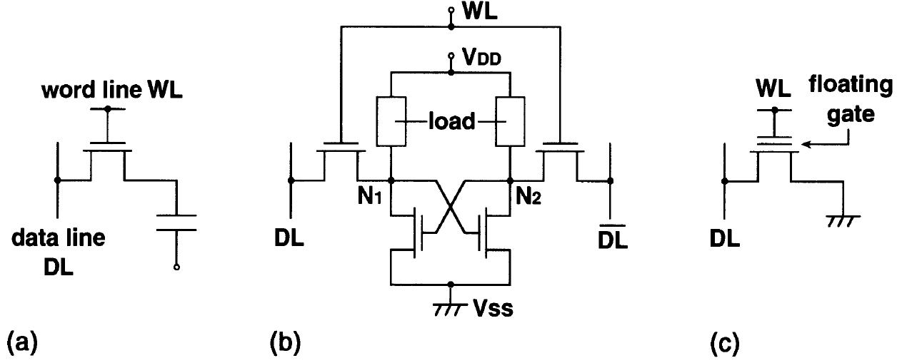
Basics of Semiconductor Memory
Memory Cell circuits; (a) DRAM; (b) SRAM; (c) EEPROM;
Notes:
Figure shows schematic circuits of memory cells, which store binary information, "I" or "0", on the previously-described memory chips. N-channel MOSFETs (NMOSFETs) are used, due to ease of explanation. A DRAM cell [1.4] comprises a MOSFET, that works as a switch, and a capacitor for storing charges. For example, non-existence of charges (electrons for NMOSFET) at the capacitor corresponds to "1", while existence of charges corresponds to "0". In other words, for the voltage expression, a high stored voltage corresponds to "I" while a low stored voltage corresponds to "0". The write operation is performed by turning on the switch and applying a voltage corresponding to the write data from the data line, DL, to the capacitor. Here, the switch is turned on by applying a sufficiently high voltage to the word line, WL. The read operation is performed by turning on the switch. A resultant signal voltage developed on the data line, depending on the stored data at the capacitor, is discriminated by a detector on the data line. In principle, the cell holds the data without power consumption.
However, a leakage current at the p-n junction in the storage node degrades an initial high stored voltage, finally causing the loss of information. This loss can be avoided by a "refresh" operation.
An SRAM cell consists of a flip-flop circuit that is constructed between a power supply voltage (VDD) and the ground (Vss) , and two switching MOSFETs. Complementary information is stored at nodes N1 and N2. That means If “1” is stored at N1 the N2 should hold the “0” value. No refresh operation is needed, because the leakage currents at N1 and N2 , if any, are compensated by a static current from the power supply, as long as VDD is supplied. Thus it allows ease of use, although the use of more FETs in a cell increases the memory cell area to more than four times that of DRAM.
Unlike RAMs, a PROM cell needs an additional erase operation, because it must be initialized to a state of non-existence of electrons by extracting electrons from the floating gate (i.e. the storage node). The succeeding write operation is achieved by injecting electrons (for writing 0) to the floating gate or not doing so (for writing 1). When we inject the electron into the floating gate “0” is written on node and we don’t inject electron “1” is written on the node. Note that, in principle, the electrons injected never discharge because they are stored at the floating gate and surrounded by pure insulators.
In an EPROM chip, the stored data of all of the cells are simultaneously erased by means of exposing the memory cells on the chip to ultraviolet rays through the crystal glass lid of the chip package. In an EEPROM chip, the data are electrically erased by a tunnel current. The erase operation is normally done for every unit of 8 bits. In particular, an EEPROM in which all the data in a chip are simultaneously erased is called Flash memory. Which you have might performed during the programming of microcontroller in your graduation.
So, in this lecture we have started the discussion from history of memory cell design and then went through different types of memory design. In the last we have briefly discussed the working of different memory cells. In the next lecture we will discuss about internal organization of memory chips. Thank you.

